Slide 1
Engineering Region Darmstadt Rhine Main Neckar

Slide 2
Notes:
Imagefilm (eingebettet): 8 Minuten
Funktioniert nur mit Internetzugang
Alternativ können Sie den Film auf DVD bei Katharina Kreutz 06151 / 871 1212 bestellen.
Kurzfilme zur Region, entwickelt von Studierenden der Hochschule Darmstadt stehen auf dem Youtube Kanal der IHK Darmstadt
https://www.youtube.com/user/IHKDarmstadt
Silicon Valley Europas (Bewerbung der IT Kompetenzen der Region)
Traumrealität (Seine Träume leben in der Region)
Lebensrhythmus (Die Region als guter Ort zum Leben und Arbeiten)
Vines (Kurzfilmchen mit Innovationen und Produkten aus der Region)

Slide 3
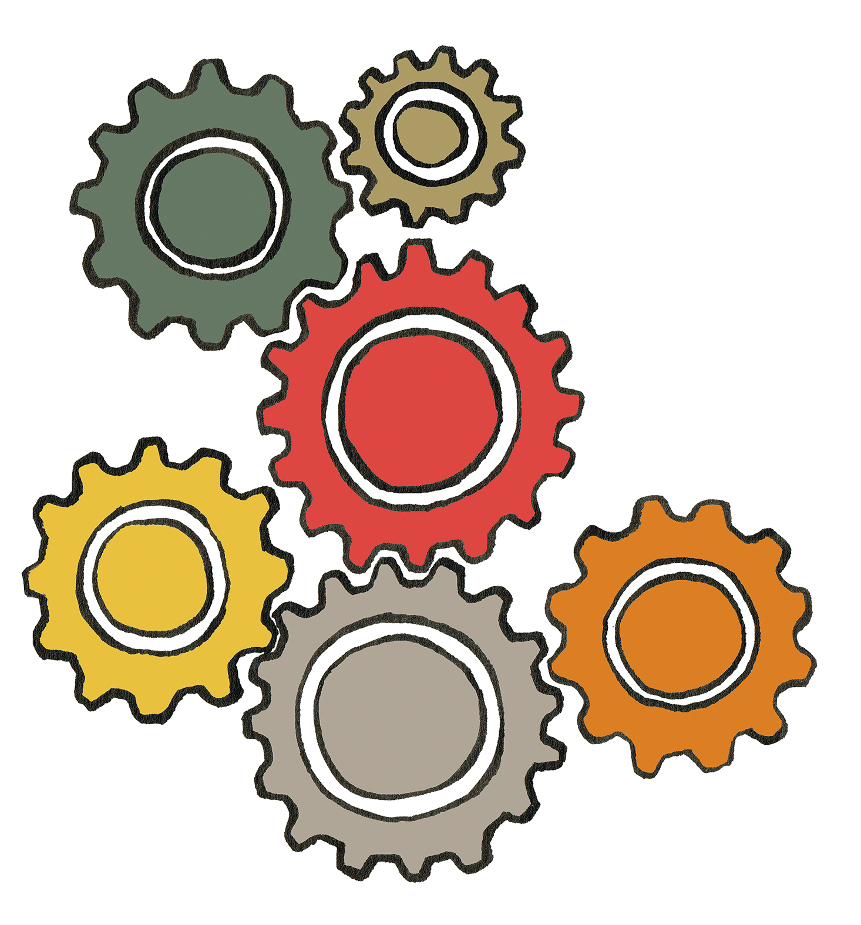
In Central Europe...
Notes:
In Central Europe...

Slide 4
...in the heart of Germany...
Notes:
...in the heart of Germany

Slide 5
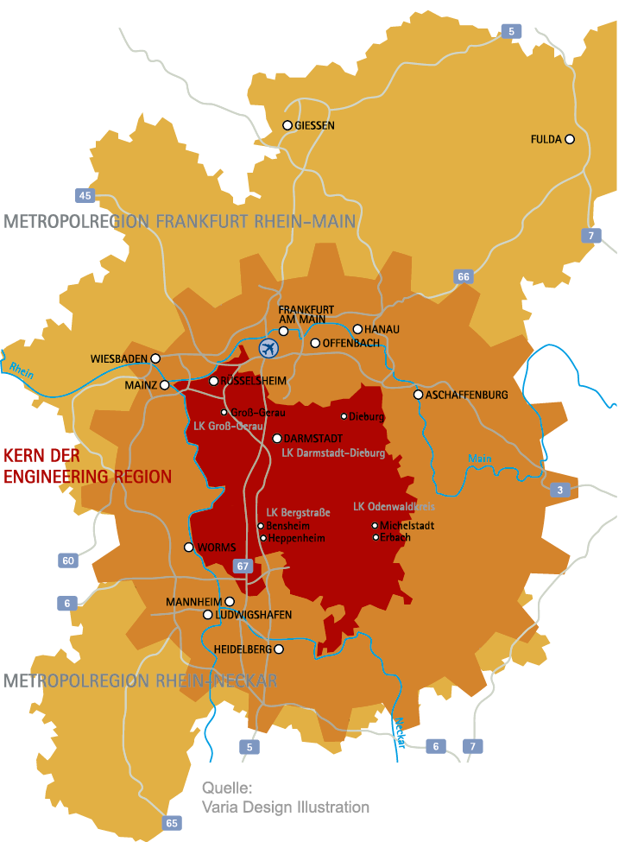
... you will find the greater region of Rhine-Main-Neckar
Facts and figures about Rhine-Main-Neckar region
736.000
98.000
7,700 square miles
Polycentric
7.8 million inhabitants
Gross value added 326 billion euros
290.000
65.000
136.000
214.000
157.000
69.000
86.000
319.000
167.000
155.000
Notes:
Anmerkung: Rhine-Main-Neckar = Gebiet der beiden Metropolregionen FrankfurtRheinMain und Rhein-Neckar (Karte: hellorange Fläche)
7,700 mi² (20.000 km²): Eight times larger than Luxembourg or half of the size of Switzerland
Bei Klick
Polycentric: within 37 miles (60 km) (=45 minutes drive by car or train) around Darmstadt you reach 8 cities with more than 100.000 inhabitants
Bei Klick
And further smaller urban centres with less than 100.000 inhabitants
All in all there are 7.8 million people living in Rhine-Main-Neckar
Bei Klick
€ 326 billion of the gross value added (2018): 11% of the German gross value added; comparable to Austria

Slide 6
... you will find the greater region of Rhine-Main-Neckar
The cities core-competences
Rüsselsheim and Aschaffenburg: Automotive
Darmstadt: IT, chemical and pharmaceutical industry
Frankfurt: Finance and chemical and pharmaceutical industry
Wiesbaden: Health
Ludwigshafen: Chemical industry
Mannheim: Machine Engineering, automotive
Mainz: Media
Whole region: automation, „Industrie 4.0“
Darmstadt, Mainz, Mannheim, Frankfurt, Heidelberg: R&D hotspots
Notes:
Automotive: Rüsselsheim (Opel and suppliers e. g. Tecosim), Aschaffenburg (suppliers, e. g. Linde Material Handling (producer of forklifts)
Chemical and pharmaceutical industry: Frankfurt (e. g. Sanofi (producer of medicin)), Ludwigshafen (BASF, worldwide largest chemical producer)
Finance: Frankfurt (seat of the European Central Bank)
Health: Wiesbaden (place for medical congresses, Abbot (develops and produces medicin, medical products and medical nutrition)
IT: Darmstadt (specialized in IT-security, Fraunhofer Institute
Machine Engineering: Mannheim
Media: Mainz with the ZDF and the SWR
Science: Universities and diverse research institutes in the cities of Darmstadt, Mainz, Mannheim, Frankfurt and Heidelberg

Slide 7
... The Engineering Region as a part of Rhine-Main-Neckar
Facts and figures about the core of the engineering region
965 square miles
more than 1 million inhabitants in
72 municipalities
65,000 industrial and trade companies
gross domestic products (GDP):
44 billion euros
12.000 apprentices
52,000 students
Notes:
Anmerkung: Core of the engineering region = Bezirk der IHK Darmstadt (Karte: dunkelrote Fläche)
Comparative figures
Area of 965 mi² (= 2.500 km²): as big as Luxembourg, but less than 1% of the size of Germany
Population: 1.3% of the German population
Gross domestic products (GDP, 2018): almost 16% of the GDP in the economically advanced Federal State of Hesse; one in every seven euros is earned here; 8,2% of the German GDP
An interconnected area
The region is intensively interconnected beyond the heart of the engineering region. Administrative boundaries play a minor role. The region around the two metropolitan regions is arguably one large interconnected area. This is reflected in the large number of commuters, business relationships and the shopping behaviour.
This is demonstrated by the "Regional Economic Integration Study for the Rhein Main Neckar Region (2013)".
Anmerkung: Daten zum Verflechtungsraum finden Sie auf Folie 5.

Slide 8
This is why we love the engineering region
universities and research institutes
strong in the field of engineering
central location
excellent transport connections
attractive commercial space
good cooperation between
business and science
high quality of life
well trained
professionals
innovative
companies
Notes:
Anmerkung: Auf die einzelnen Stärken wird in den folgenden Folien eingegangen; je nach Zielgruppe können einzelne Stärken umsortiert oder gelöscht werden.
strong in the field of engineering: (Anmerkung: siehe nächste Folie)
Information and communications technology
Automation and production
Chemicals/pharmaceuticals/materials/biotechnology
Environment/energy
Automotive/mobility
Logistics
Central location: as shown before: in central Europe, in the heart of Germany
transport infrastructure: Easily accessible by any means of transport: rail, car, air, water(Anmerkung: siehe nächste Folien)
attractive commercial space (Anmerkung: je nach Zielgruppe evtl. dazu passende Folien ergänzen)
Well trained professionals thank to the universities and the German dual education system
good cooperation between business and science: (Anmerkung: siehe auch in folgenden Folien)
...three universities and four research institutes specialising in engineering are located in the heart of the engineering region
...more than 40 other universities and over 50 research institutes are located in the immediate vicinity
They are interacting fruitfully with the companies

Slide 9
Strong in the field of engineering
Our references are:
Information and communications technology
Automotive/mobility
Chemicals/pharmaceuticals
Automation and production
Logistics
Environment/energy
Notes:
Many well-known major companies, such as Opel, Merck, Pirelli, Software AG, Suzuki International Europe, Langnese or Deutsche Telekom have their headquarters in our engineering region.
There are also many small and medium-sized companies: These include a whole string of so-called hidden champions, often unknown companies that are global market leaders in their special field!
Examples of hidden champions: Caparol from Ober-Ramstadt (Alpinaweiß paint), Coolike from Bensheim (wet towels), Aquanova in Darmstadt (natural dyes), Brain AG in Zwingenberg (washing agents), Röhrig Granit from Heppenheim (gravel for road construction), etc.
The region is particularly well positioned in the automation, automotive, logistics, chemical, pharmaceutical and renewable energy sectors as well as in the field of IT. Hence the name, engineering region.
The region is also the centre of European aerospace: The European Space Operations Centre (ESOC) in Darmstadt controls all European satellites. Next door, EUMETSAT operates the weather satellites whose images provide the basis for weather forecasting in Europe.

Slide 10
Excellent connections through Frankfurt/Main International Airport
1 hour, 25 minutes
Frankfurt/Main
Paris
1 hour, 50 minutes
Frankfurt/Main
London
8 hours
Frankfurt/Main
New York
Notes:
Anmerkung: Ziele können je nach Zielgruppe individuell gewählt werden

Slide 11
Excellent connections with public transportation system
20 minutes by train; several times per hour
Darmstadt
Frankfurt/Main
30 minutes by bus;
Every hour
Darmstadt
Frankfurt/Main Airport
250 minutes by train;
several times per hour
Frankfurt/Main
Berlin
Dense network of public transportation in the cities with busses and streetcars.
Notes:
Regional traffic as well as longdistance traffic
ICE (InterCity Express):
ICE hubs in Frankfurt and Mannheim with connections to German cities, e.g. Berlin (by sprinter in less than 4 hours non-stop from Frankfurt as well as non-stop to Brussels (200 minutes), Paris (230 minutes), Marseilles and Amsterdam.
Dense network of public transportation in the cities with busses and streetcars
Water:
Mannheim port: the second largest inland port in Europe (after transhipment)
Conclusion:
• Ideal conditions for corporate headquarters
• Excellent "cut-off times" for overnight deliveries (deadlines for deliveries from one day to the next can be met )

Slide 12
Advances in science thanks to universities and research
Here we have...
...three universities and four research institutes specialising in engineering are located in the heart of the engineering region
...more than 40 other
universities and over 50 research
institutes are located in the immediate vicinity
Notes:
Well trained professionals:
About 8,500 graduates at the universities in the heart of the engineering region in 2019
In addition, about 3,000 graduates in a dual training programme (in industry and trade alone) in the heart of the engineering region in 2019

Slide 13
Successful cooperation
Interacting fruitfully:
business and science
Companies within
an industry sector
Companies from
different sectors
Notes:
Examples of cooperation
Between business and science: "Proreta" interdisciplinary research cooperation:
Continental and the Technical University of Darmstadt are working on a driver assistance system that is designed to prevent accidents.
Satellite monitoring system for sea containers: Socratec Telematic GmbH (Bensheim) and BSC Computer GmbH (Allendorf) with Hochschule Darmstadt
Secure and encrypted conference call: toplink GmbH (Darmstadt) and Hochschule Darmstadt
Universal and modular radio-based system for intelligent building technology (Smart Home): media transfer AG (Darmstadt) and Jäger Direkt Jäger Fischer GmbH & Co. KG (Reichelsheim) withHochschule Darmstadt
Research tram for automated driving: HEAG, die HEAG mobilo, die TU Darmstadt, die Deutsche Telekom AG und die Digitalstadt Darmstadt; The aim of the project is to explore the potential of tram automation by April 2021.
Development of a decentralized networked 3D head scanner system: Jotena3D e.K. (Startup aus dem HUB31) with Fraunhofer Institute for Computer Graphics Research (IGD)
Within an industry sector:
A cluster, for example, in the field of automation, automotive and IT and a software cluster (around Darmstadt, Kaiserslautern, Karlsruhe, Saarbrücken and Walldorf) received an award in the Cluster of Excellence competition organised by the Federal Government (funding of € 80 million from 2010-2015). The region is considered the European Silicon Valley for business software.
Between companies from different industry sectors:
The Wetropa Group (foam fabricators) and Bright Solutions (software developers): customers can develop individual foam inserts for tool boxes using an online configurator.
Location system and theft protection for bicycles: Riese & Müller mit der IoT Venture GmbH (Startup aus dem HUB31)
Energieeffizienz-Netzwerk ETA-Plus: The ETA-Plus energy efficiency network brings together companies that want to increase the energy efficiency of their operations in a cost-effective and time-efficient manner and thus reduce their energy costs. This saves 10 million kWh of energy per year.
(Mit Klick erscheint IHK-Logo)
Promotion of clusters by the Chamber of Industry and Commerce (IHK) The IHK supports the "IT for work", automation region and automotive cluster networks and „Energieeffizienz-Netzwerk ETA-Plus“
.
(Mit Klick erscheint Pokal)
EU award Darmstadt was number 3 in the "Existence of strong clusters in emerging industries" category (EU Commission study 2016)

Slide 14
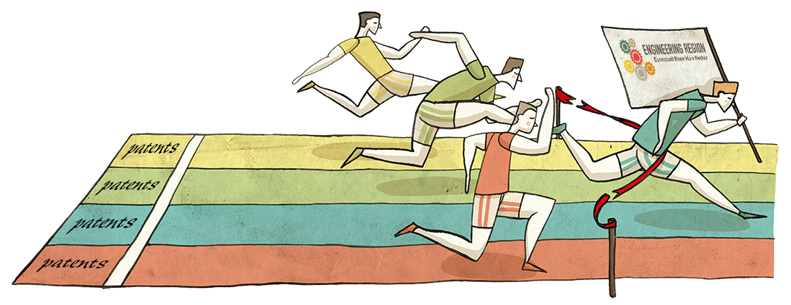
Nurturing innovations
Innovation data show:
Darmstadt in the Rhein Main Neckar region shows an above average capacity for innovation in a nationwide comparison.
6.5 % of the GDP goes in R&D expenditures
Above-average number of patent application
Notes:
The engineering region has the networking of universities, research institutes and companies as well as its well trained professionals to thank for its performance
The innovation study confirms the following: Darmstadt Rhein Main Neckar engineering region demonstrates above-average innovation compared to the rest of the country!
Comparative figures:
R&D: Hesse 2.4 %, Germany 1.9 %, Munich 4.1 % (2013!)
Background information on the innovation study:
Study by the Germany Institute for Economic Research (DIW) on behalf of the Chamber of Industry and Commerce (IHK) in 2013
Region studied: Darmstadt Chamber of Industry and Commerce district
The study examined and compared innovation indicators, such as the number of students, number of patent applications and number of people working in research and development in six Germany regions.
Regions compared: Dresden, Karlsruhe, Munich, Nuremberg, Stuttgart
Engineering region harnesses research
An exhibition of "150 innovations made in Southern Hesse" from the anniversary year of 2012 shows a selection of innovations from the region
Examples: Plexiglas, dry shaver (Darmstadt, 1949), Resopal (Groß-Umstadt, 1930), 3d camera for producing dentures (Bensheim, 2000), Adam Opel developed HydroGen3, the first fuel cell vehicle with approval for use on public roads in Germany (Rüsselsheim, 2001), Merck liquid crystals (Darmstadt, 1968)

Slide 15
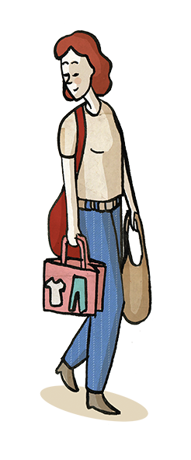
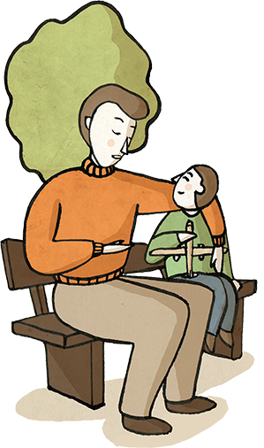
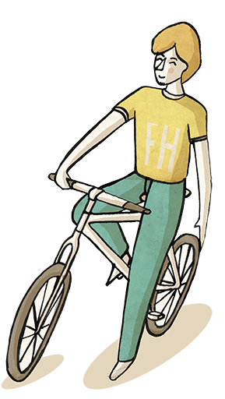
I love living here because...
„... the range of cultural activities here is
very extensive.“
„... I live in a central location, with good transport connections, and can also get into the countryside quickly. And it is a safe region.“
„... I can reach a wide variety of towns for
going shopping in a
very short time.“
Notes:
Countryside: Almost 50 % of the area of Darmstadt is covered with forest
Safety: According to criminal statistics Darmstadt is the safest urban municipality city in Hesse (2018)
Shopping: In bigger citties like Darmstadt, Frankfurt, Heidelberg, Mannheim, Mainz or Wiesbaden; or in the smaller ancient towns like Michelstadt
Cultural activities: Explore the Jugendstil in Darmstadt, the wine festivals at the Bergstrasse or enjoy the World Heritage sites like Kloster Lorsch

Slide 16
Why we, the Chamber of Industry and Commerce, are marketing the engineering region
We want to support our member companies in national and international competition.
Our aims are quite specific:
Strengthen the business location
Attract professionals to companies in the region

Slide 17
Thank you for your attention!
Contact:
IHK Darmstadt Rheinstraße 89 64295 Darmstadt
Notes:
Kontaktdaten eintragen

